Slide 1
TecBidder By, JUHI JOY SJC16MCA24 Under the guidance of Mrs.Soumya George, Asst. Prof, MCA

Slide 2
Presentation Outline
Introduction
Problem Definition
Objective of project
Technology Used
Modules
DFD
Activity Diagrams
User story
Design and Testing
Unit Testing
Validation Testing
Conclusion
References

Slide 3
Introduction
The project “TecBidder” is an online auction system that provide a platform for the customer to buy the products by bidding in a competitive manner. TecBidder has introduced a completely new and funny way of online shopping. TecBidder.com is a new exciting auction website where you can win branded new products at huge discounts. Tecbidder gives an opportunity to those people who can't afford to purchase costly branded products, they can try our risk-free auctions to win their desired products like Smartphones, Laptop, Tablets & branded watches.

Slide 4
Problem Definition
According to current tendency of people everyone is trying to purchase from online rather than going to shop for their needs.
when people are purchasing from online most of the time, they will not get more additional benefits. Because of the inefficiency of the current system consumer will not get more benefits.
However, the proposed system will remove these inconveniences and will ensure customer satisfaction
The proposed system provides a platform for the customer to buy the products by bidding in a competitive manner.

Slide 5
Objective
The purpose of “Tecbidder”, is to provide users a platform for buyers and sellers to come together and trade electronics. It aims at accuracy, efficiency and security.
Significantly reduce the use of physical money
An bidding environment for our customers
Accurate product and pricing information
Constant innovation and development of new features
Long-term relationship with our suppliers and partners

Slide 6
Technology Used
Front End | Microsoft Asp. Net
Back End | SQL server 2014
Tools | Network Framework 4.5
Operating System | Windows 10
Software | Microsoft Visual Studio 2015

Slide 7
Modules
Admin Module
Buyer Module
Seller Module
Payment Module

Slide 8
Admin Module
This module is the major part of our system. Admin can control over all working of system. Admin can see each and every sellers and buyers in the system each time admin will get reports from the system. The buyers in the system require credits to do purchase from the system that is given by the admin.
Buyers will pay to admin by using credit card or Net banking method admin have separate login into the system after login into the system he/she can see the current bids, closed bids, upcoming bids etc.

Slide 9
Buyer Module
This module facilitates the buyer to login into the system and he can do bidding on the system.
The Buyer need to buy credits to participate in online bidding.
Registration is free, secure and simple.
Buyer can sign in into the Tecbidder account from the home page. If the customer is an already user, he can login by using Tecbidder id.

Slide 10
To place bids on any auction, buyer need to buy Credits.
Buyer can buy Credits by multiple payment methods, including: Debit/Credit Cards, VISA, MasterCard, Net Banking, Cash Cards etc.
Real Competition starts when last few Seconds are remaining in Timer.
Once Auction starts... Click on the 'BID NOW' button to place your bid. Each time you place a bid, number of Credits will be deducted from your balance, and time to the clock will be added. Time is added to clock every time a user places a 'BID'. This gives enough time for someone else to make the decision to BID if they are interested. You are the last bidder when timer expires.

Slide 11
Seller Module
Each and every seller should register in the system to use system. Once a seller signed in the system, he can use the login option
At the next time. Seller can sell his products to different buyers by put that for bidding.
Seller can see each and every bid that happened on his/his product. Once bid happened on one product the payment is done user to seller.
Seller can see the payment history and different ordered products. Seller can set base amount for his/her product.
There is no intermediate between user seller payment processes. Whatever the amount paid by the buyer is directly go to the seller.

Slide 12
Payment Module
Payment module is the important module of the system Tecbidder.
There are two different types of modules in the system.
One is the payment from user to admin and another one is the payment from buyer to seller.
Buyer want to buy credits from admin then only he can able to participate in the bidding.
Once a buyer won in bidding, he wants to order the product by pay the amount then only he can able to claim that the product is his own.

Slide 13
Data Flow Diagram

Slide 14
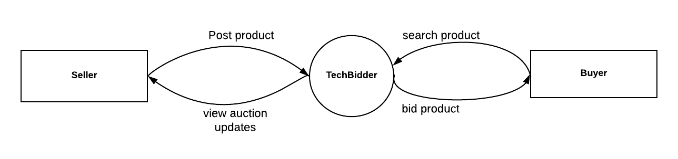
Context Level

Slide 15
Level 1

Slide 16
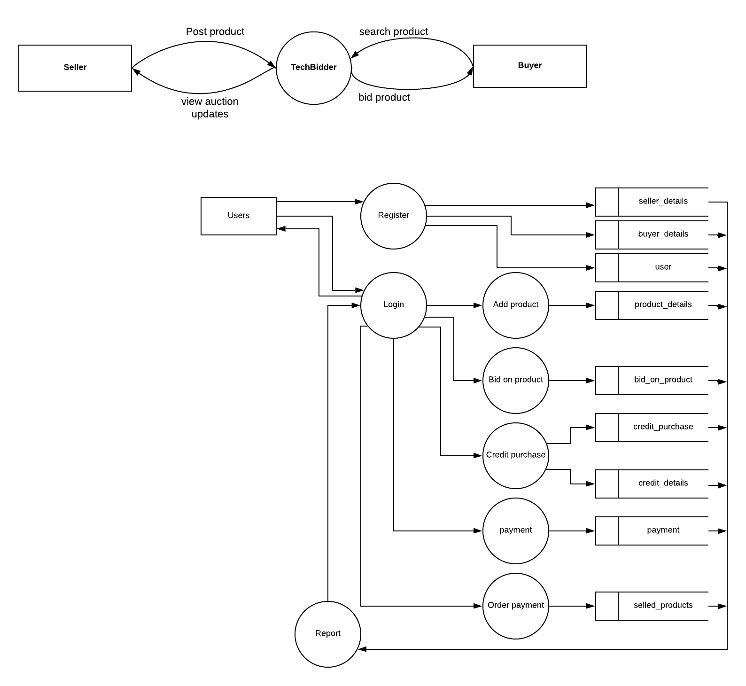

Slide 17
Activity Diagram

Slide 18
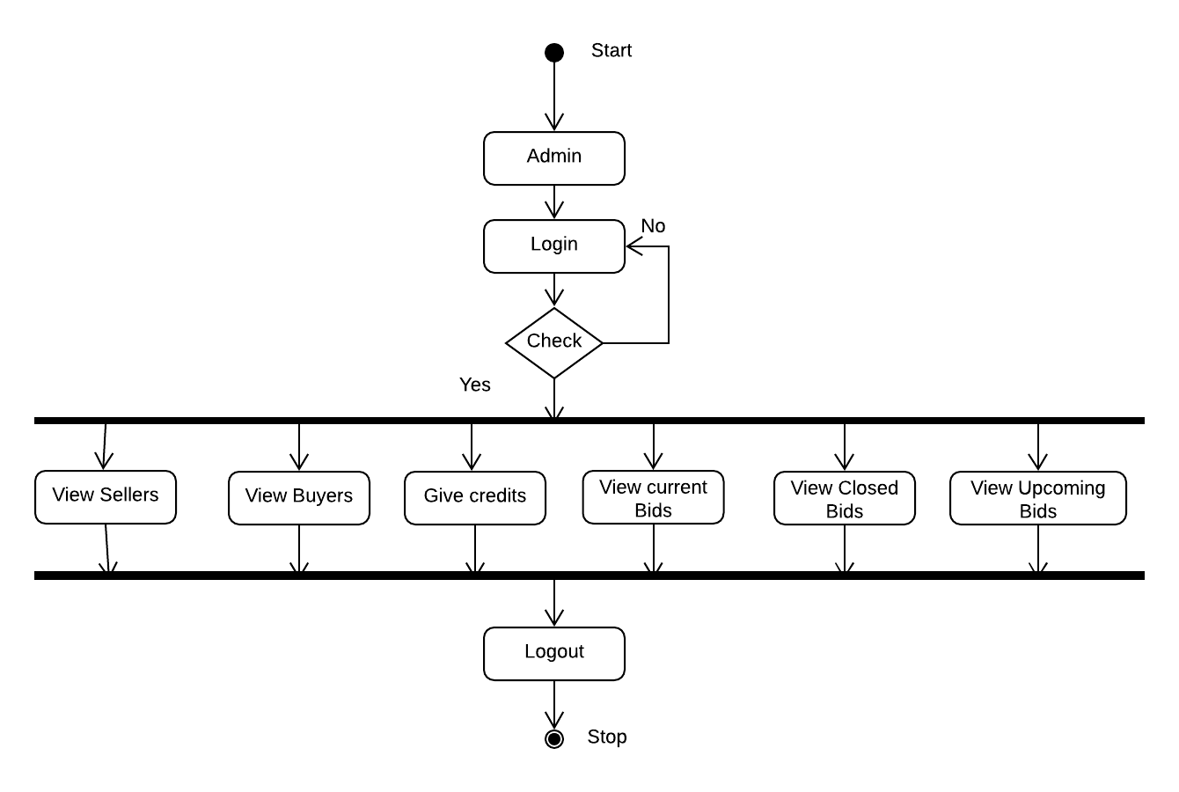
Activity diagram for Admin

Slide 19
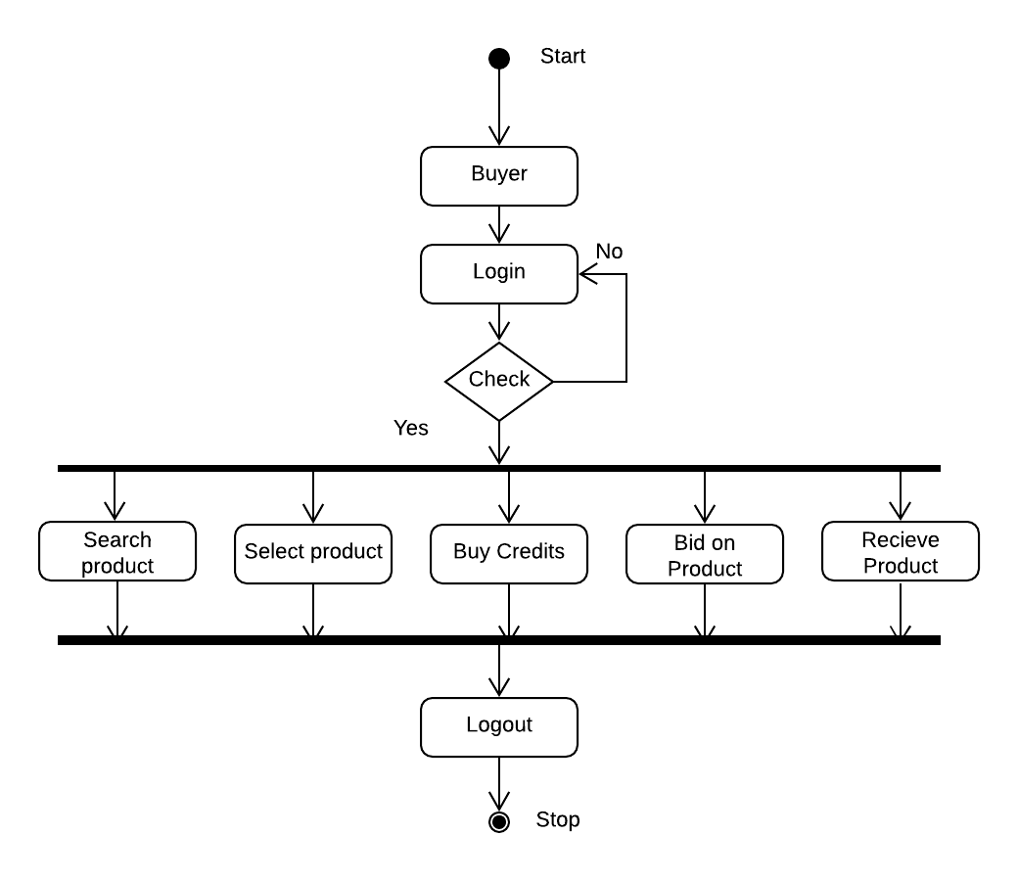
Activity Diagram for Buyer

Slide 20
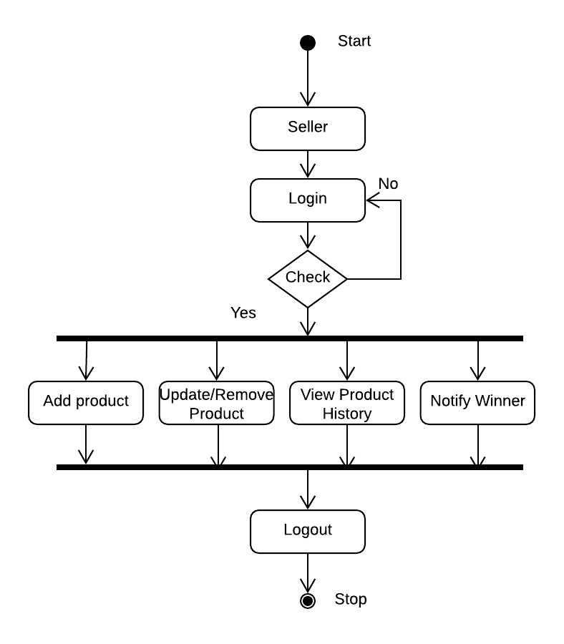
Activity Diagram for Seller

Slide 21
Table Design

Slide 22
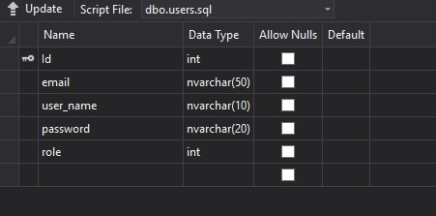
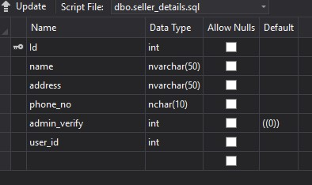
Users table
Seller_details table

Slide 23
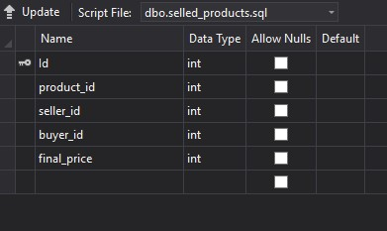
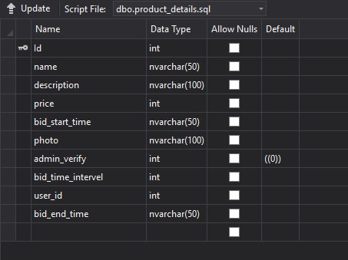
selled_products
product_details

Slide 24
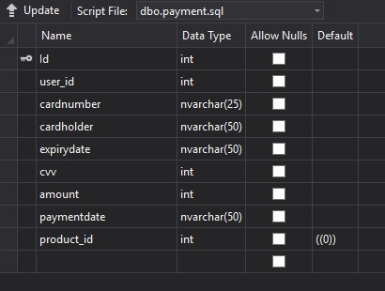
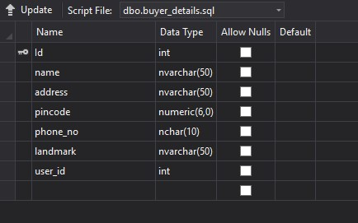
payment
Buyer_details

Slide 25
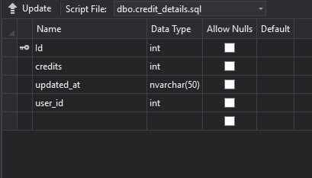
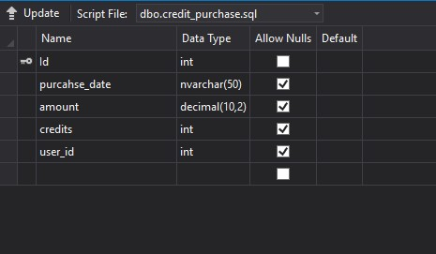
Credit_details
Credit_purchase

Slide 26
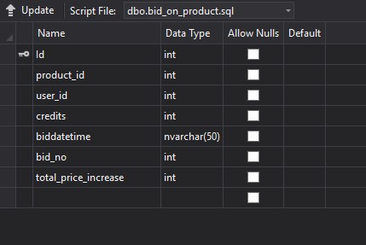
Bid_on_product

Slide 27
User Stories

Slide 28
 |  | USER STORY
 | TecBidder
SL.No | FEATURES | SUB FEATURES | BREAK DOWN EPICS INTO STORIS | RELEASE 1
1 | User | Registration | (name)(email)(username)(password)
 |  | Login | user name and password
2 | Admin | login
 |  | see seller | (seller name)(edit&delete seller details)
 |  | see buyer | (buyer name)(edit &delete buyer details)
 |  | logout
3 | Seller login | login
 |  | add product | (upload product picture)(starting price)(set bid time)(description)
 |  | view payment history | (card holder)(card number)(amount)(product name) (product image)(payment time)
 |  | view product orders | (product image)(product name)(consumer name) (phone number)(order date)
 |  | logout
4 | Buyer Login | Login
 |  | Search bid
 |  | Buy credits | (card number)(name)(security number)
 |  | Bid on product | (product name)(bid price)(bid creadits)(bid time)
 |  | logout

Slide 29
Validation Testing

Slide 30
SL.NO | Page | Test Step | Expected Result | Actual Result | Status | Remarks (if any)
1 | User Login | User Click LOGIN button without enter username and password | Messgae like "Please fillout this field" should be appear | Message like "Please fillout this field" appear | Pass | None
 |  | User enter valid Username and invalid password | Message like "Check your credentials"should appear | Message like "Check your credentials" appear successfully | Pass | None
 |  | User enter non-existing username and password | Message like "Check your credentials"should appear | Message like "Check your credentials" appear successfully | Pass | None
 |  | user enter valid username and password | page should be naviagte to home page | Page Naviagted to home page | pass | none
2 | Product for bid | Seller click Add product button without enter product desc | Message like "Please fillout this field" should be appear | Message like "Please fillout this field" appear | pass | None
 |  | Seller click Add product button by provide necessary fields | Page should Naviagte to home page | The page navigated to home page successfully | pass | None
3 | Bid product | Buyer logged in and click BID NOW button without buy credits | Messge like "You Don't have enough credits" Please buy some credits! Should be appear | Messge like "You Don't have enough credits" Please buy some credits! appear successful | Pass | None
 |  | Buyer logged in and click BID NOW button with enough credits | Message like "Do you want to bid on this product" should be appear | Message like "Do you want to bid on this product" appear successfully | pass | none
4 | Payment | Buyer enter invalid card number | Page should not respond | Page not respond | pass | none
 |  | Buyer enter valid card number and invalid cvv number | Page should not respond | Page not respond | pass | none
 |  | Buyer click Pay button without enter expiry date | Message like "Please fillout this field" should be appear | Message like "Please fillout this field" appear | pass | none
 |  | Buyer Click Pay button with enter necessary fields | page Should navigate to home page | page navigated to home page | pass | none

Slide 31
Unit Testing

Slide 32
SL.NO | Page | Test step | Expected Result | Actual Result | Status | Remarks (if any)
1 | User Login | User enters valid username and password to login to system | validate the user and Login should be successful | Login Succes | Pass | None
 |  | Users enters invalid username and password to login to system | should show an error message | show error message | Pass | None
2 | Product for bid | Seller able to add product by providing necessary details | Adding product should be successful | Successfully product is posted in the live auction on the home page and visible to user's view | Pass | None
 |  | Seller add product without providing necessary details | Adding product should not be successful | Nothing happened | Pass | None
3 | Bid product | Buyer Logged in and Click "BID NOW" button without enough credits | should show an error message | Show error message | Pass | None
 |  | Buyer Logged in and Click "BID NOW" button with enough credits | Buyers able to bid product | Buyer bid product successful | Pass | None
4 | Payment | Buyer click Pay button enter invalid card number | Page should not respond | page not respond | pass | none
 |  | Buyer click Pay button with enter valid card number and invalid cvv number | Page should not respond | page not respond | pass | none
 |  | Buyer click Pay button without enter expiry date | Page should not respond | page not respond | pass | none
 |  | Buyer Click Pay button with enter necessary fields | Admin provide access to bid product | Get access to bid product | pass | none

Slide 33
User Interfaces

Slide 34
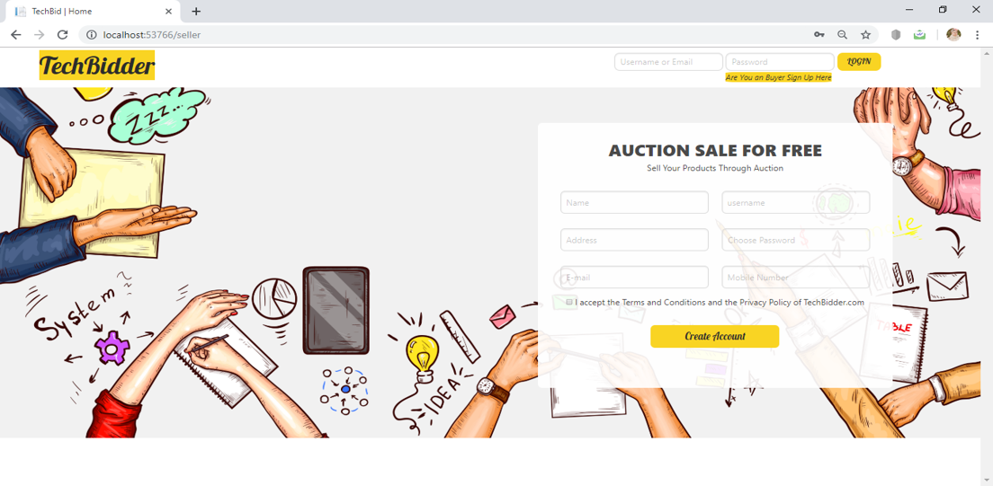
Seller Login

Slide 35
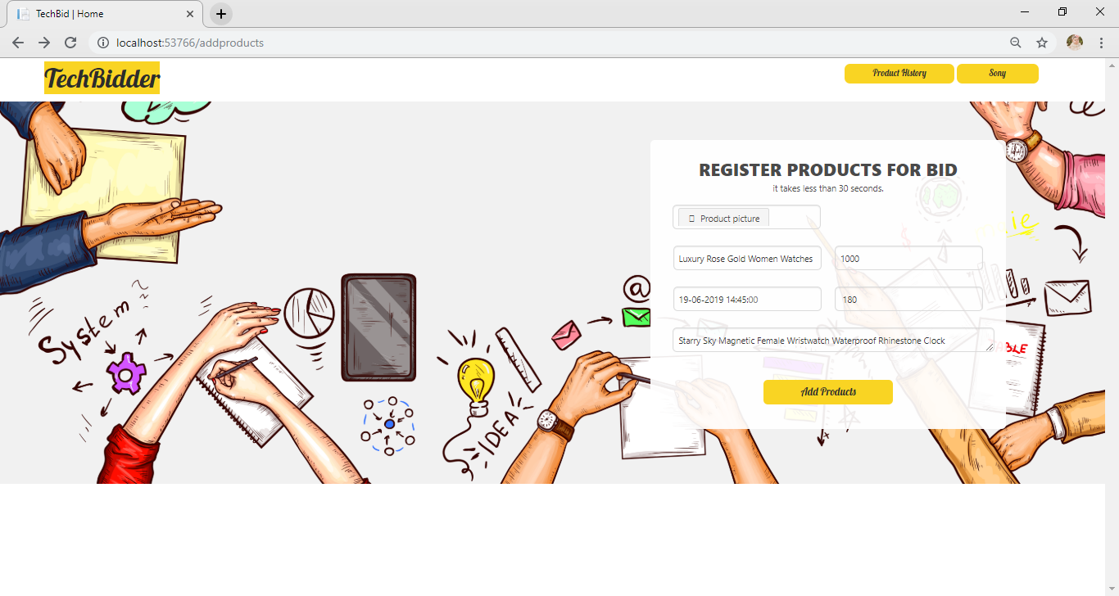
Register product by seller

Slide 36
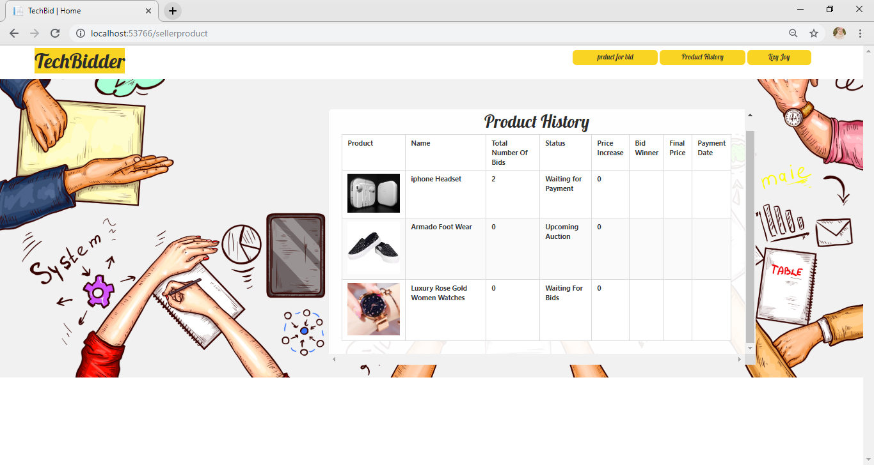
Product History of Seller

Slide 37
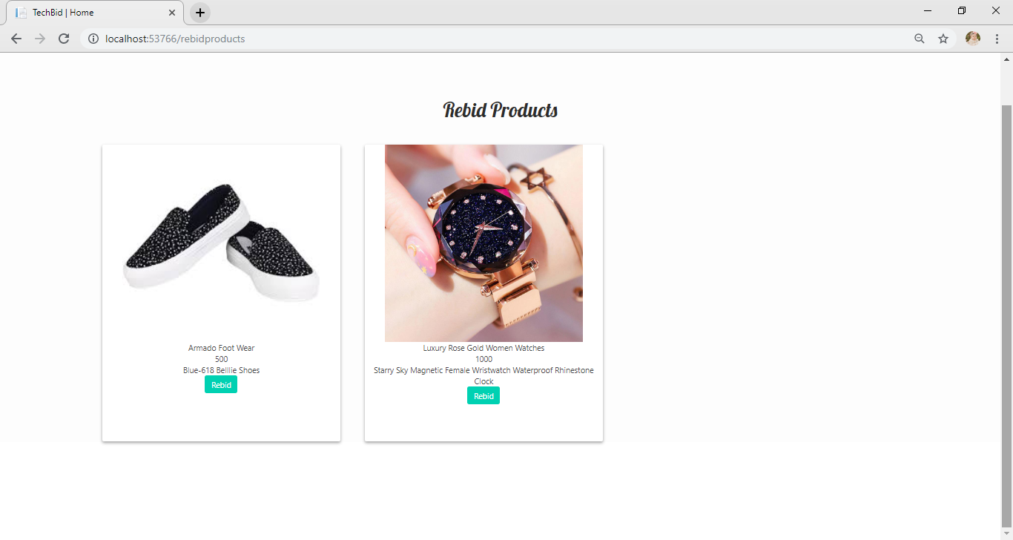
Rebid products

Slide 38
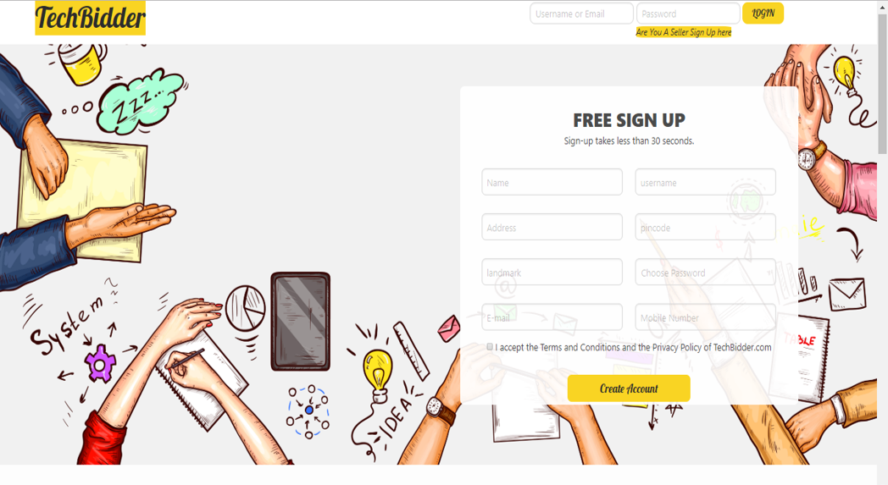
Buyer Register/Login

Slide 39
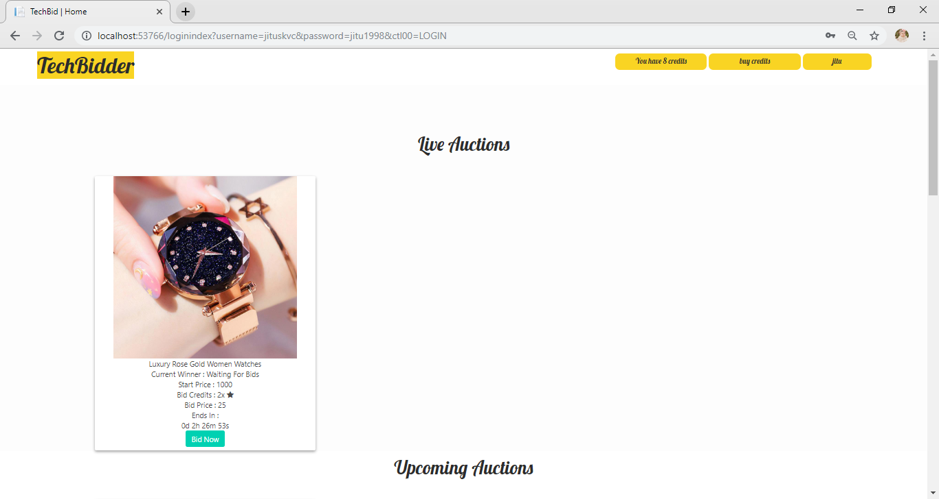

Slide 40
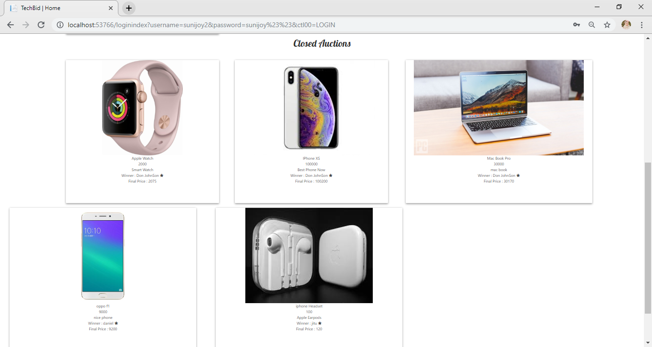
Closed Auction

Slide 41
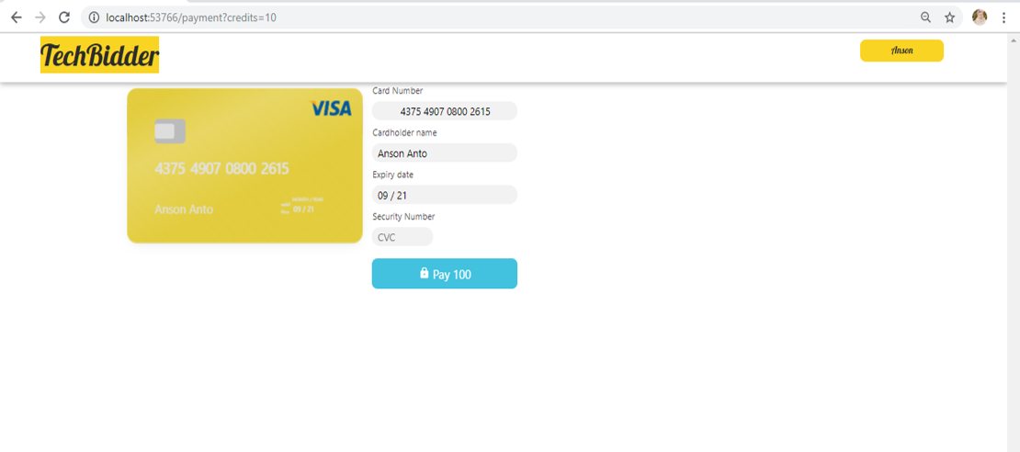
Buy credits

Slide 42
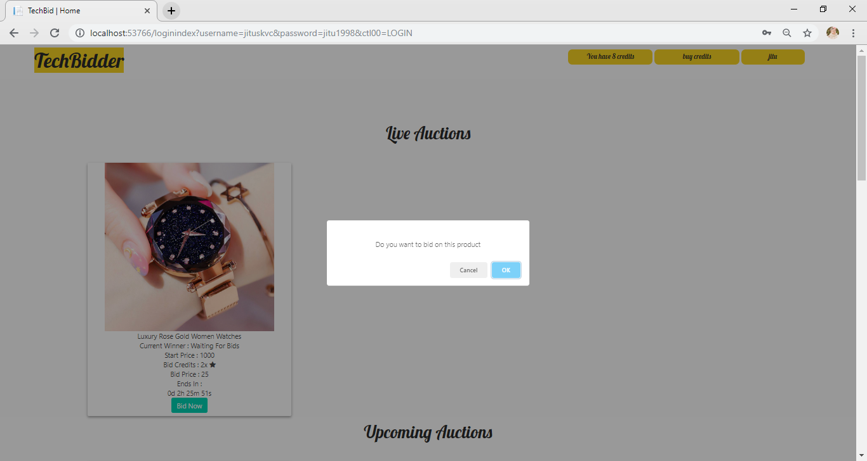
Bid on product

Slide 43
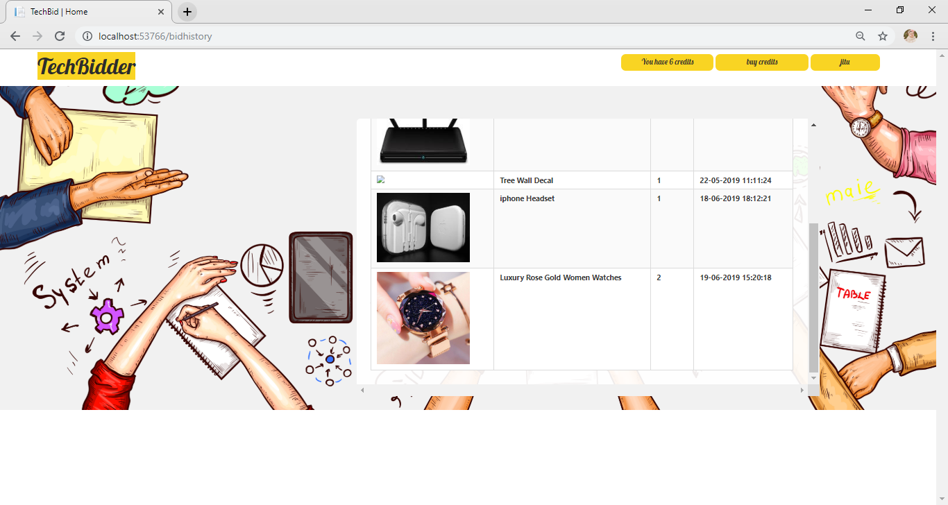
Bid History

Slide 44
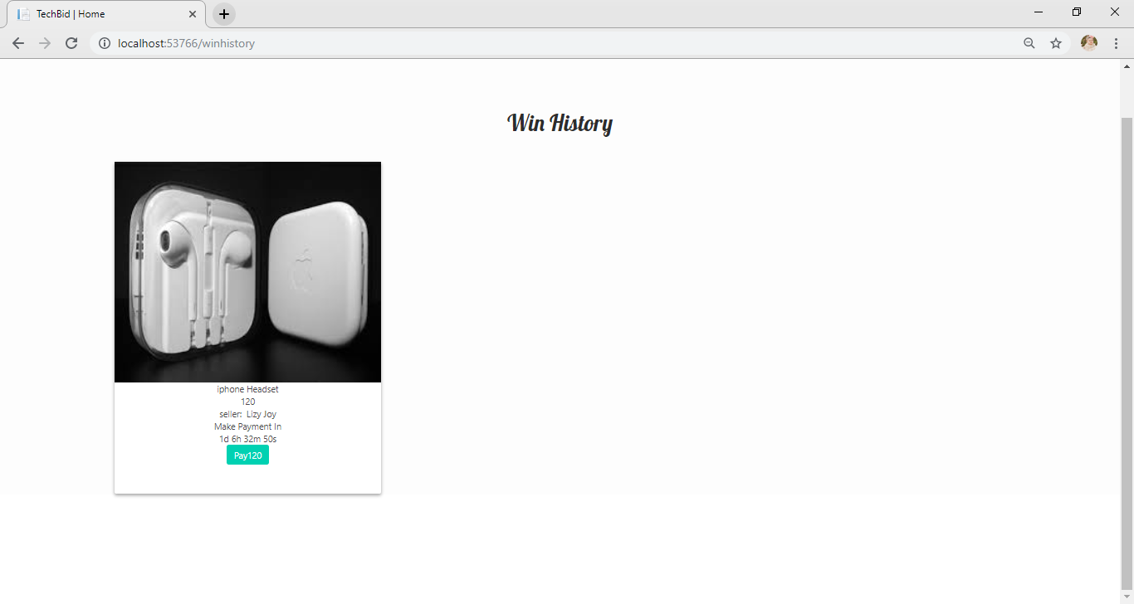
Win History of Buyer

Slide 45
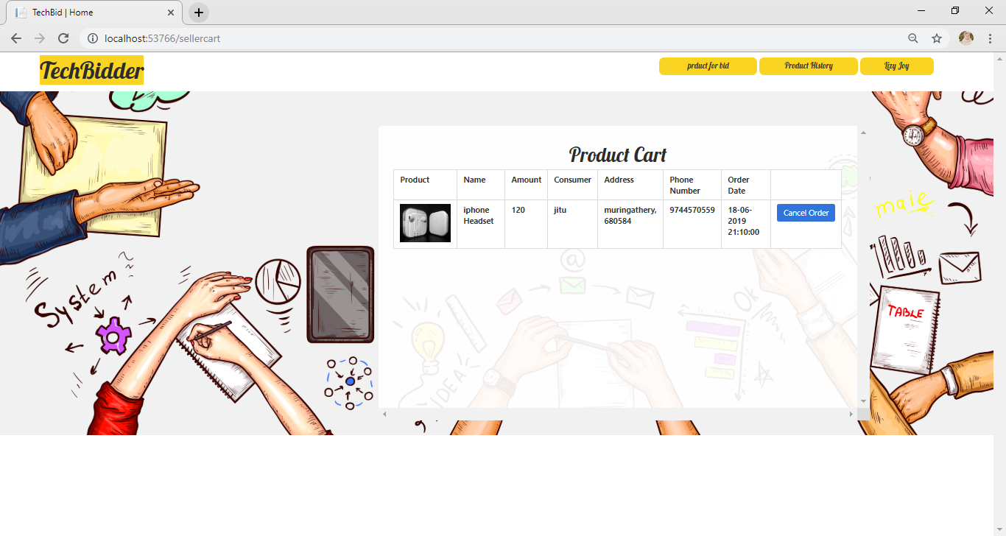
Seller can cancel order in product cart

Slide 46
Conclusion
The introduction of Tecbidder can greatly benefit the customers by making it very easy for them to do online purchase in new and interesting manner. It is not just providing an Ecommerce website but also give additional benefits for the user. The analysis as of now is that compared to other E-commerce websites our system can genuinely improve the reliability of the service while also provide additional features for the user. It provide an ethical bidding environment for our customers also provide accurate product and pricing information .Tec bidder not just providing an E-commerce site. It gives an opportunity to those people who can't afford to purchase costly branded products, they can try our risk-free auctions to win their desired products like Smartphones, Laptop, Tablets & branded watches.

Slide 47
References
“The Complete Reference ASP. Net” 2002 Edition by Jeffery R.Shipario published by Tate McGraw-Hill.
“ASP. Net Programming”2002 Edition by Peter Aitken published by Dream Tech New Delhi.
WEB SITES
https://www.youtube.com/watch?v=zFYoskhjt0Q&list=PLN_YHff_frgw4kw VV7gOaC9VLeAipd64 v
https://www.youtube.com/watch?v=J7aStGi3hE8
http://servicevet.vet

Slide 48


